Slide 1
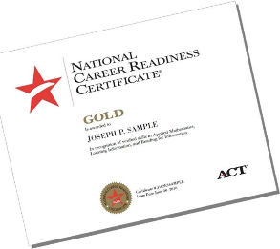
WorkKeys Information

Slide 2
What is WorkKeys?
WorkKeys® is a skills assessment system from ACT that helps employers select, hire, train, develop, and retain a quality workforce.
The assessments measure 8 foundational skills (• Applied Mathematics • Applied Technology • Business Writing • Listening for Understanding • Locating Information • Workplace Observation • Reading for Information • Teamwork ) and 3 soft skills (• Fit • Talent • Performance).

Slide 3
WorkKeys
WorkKeys assessments measure skills that employers feel are essential to success in the workplace. Better skills mean better-paying jobs—in any career field.
Students, job seekers, and seasoned professionals can use WorkKeys to learn more about their strengths and weaknesses and gain a valid way to demonstrate their abilities to employers.
Educators and employers can use it to help take the guesswork out of determining student, applicant, and employee qualifications.

Slide 4
The WorkKeys System
The WorkKeys system consists of job profiling (finding out which skills are needed on the job), assessments (the tests you’ll be taking plus several others), reporting (telling you how your skills match job requirements), and instructional support (guidance to educators related to improving students’ skill levels).

Slide 5
Who can take WorkKeys?
–WorkKeys is free of charge to all NC senior CTE concentrators
Successful completion of WorkKeys assessments in Applied Mathematics, Locating Information, and Reading for Information can lead to earning the National Career Readiness Certificate™ (NCRC®), a portable credential earned by more than 3 million people across the United States.

Slide 6
Am I a CTE Concentrator?
–Have you taken Four or more CTE Courses in a cluster? CTE Career Cluster/ Concentrator Document
–Have you taken at least one completer course in a cluster? (Second Level Course: Foods I, Foods II)
–Or, have you at least three foundational courses, one being an enhancement.

Slide 7
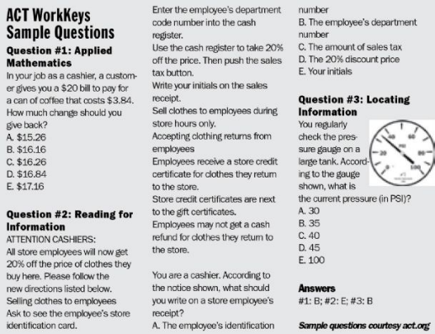
How Can you prepare for workkeys?
Sample questions and practice tests will help individuals build skills at their own pace

Slide 8
WorkKeys Test TAking Strategies
•Pace yourself
•Listen to and read the directions for each test carefully
•Read each question carefully
•Answer the easy questions first
•Use logic in more difficult questions
•Answer every question
•Review your work
•Be precise in marking your answer document
•Erase completely

Slide 9
Now you know...
This school year, about 120 seniors will be taking the WorkKeys assessment!
Can’t Wait!
WorkKeys is a job skills assessment system measuring "real-world" skills that employers believe are critical to job success.

Slide 10
THANKS
Any questions?
Mrs. Candice McCaskill will be organizing and administering WorkKeys
You can find her at
cmccaskill2@wcpss.net

